Slide 1
How to use Lab equipment remotely

Slide 2
1. Download WinClient
The KVM in the lab is internet connectable, use WinClient.exe to connect to KVM
Create a folder named “WinClient” to save it.
Download link: https://github.com/BeyondsoftTaiwan/LabResources/releases/download/V1.1.109/WinClient.exe

Slide 3
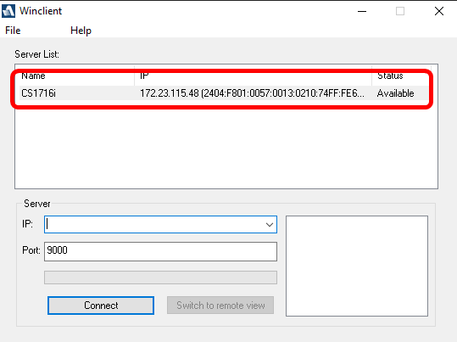
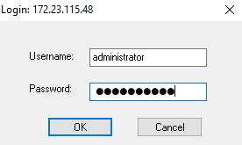
2. Open WinClient
After downloaded, open WinClient.exe. It will auto scan the compatible device.
Double click on the device name and enter the UN and PW(lowercase)
UN: administrator
PW: adminadmin

Slide 4
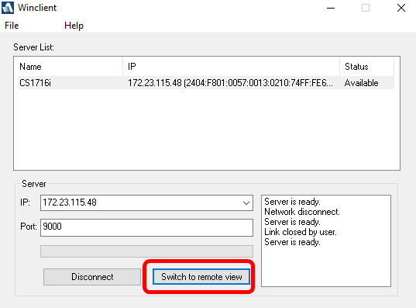
3. Connect to WinClient
After entered UN and PW correctly, click “Switch to remote view”

Slide 5
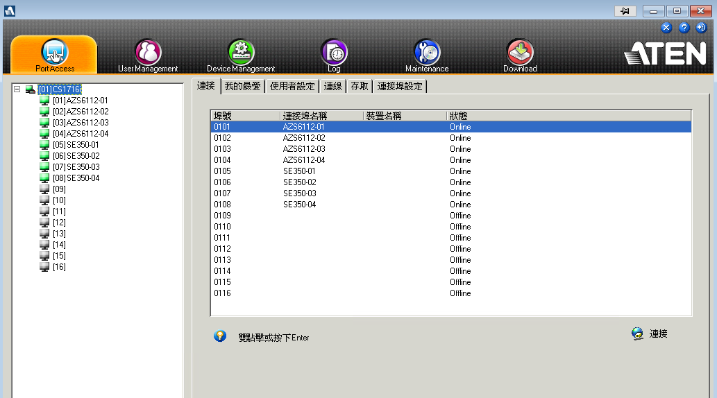
4. Control remote server via KVM
Double click on the device that you want to connect it.

